Slide 1




Automation and Control of Hydroponic Systems

Slide 2

Team MEMBERS
Marshall Amey (Team Leader)- Major: Electrical Engineering
Kathya Alfaro- Major: Computer Engineering
Isaac Olson- Major: Mechanical Engineering
Madeline Wrzesinski- Major: Computer Engineering

Slide 3
Research Goal:
The goal of this research project was to design, build, and test a low-cost prototype system to automate and control critical variables of the environment in a containerized hydroponic garden.

Slide 4
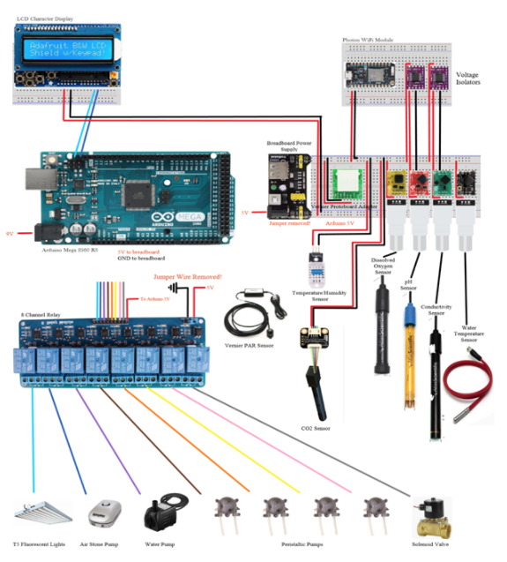
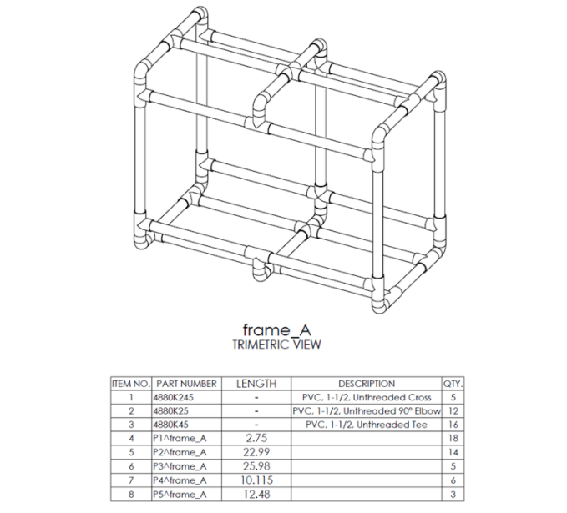
Concept and design

Slide 5
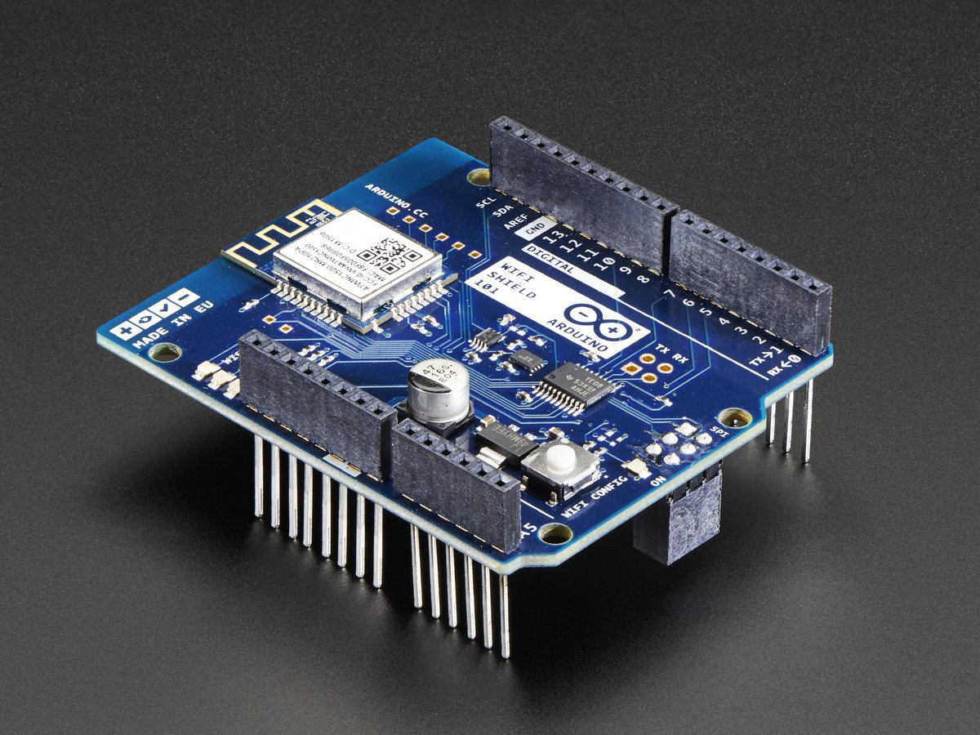

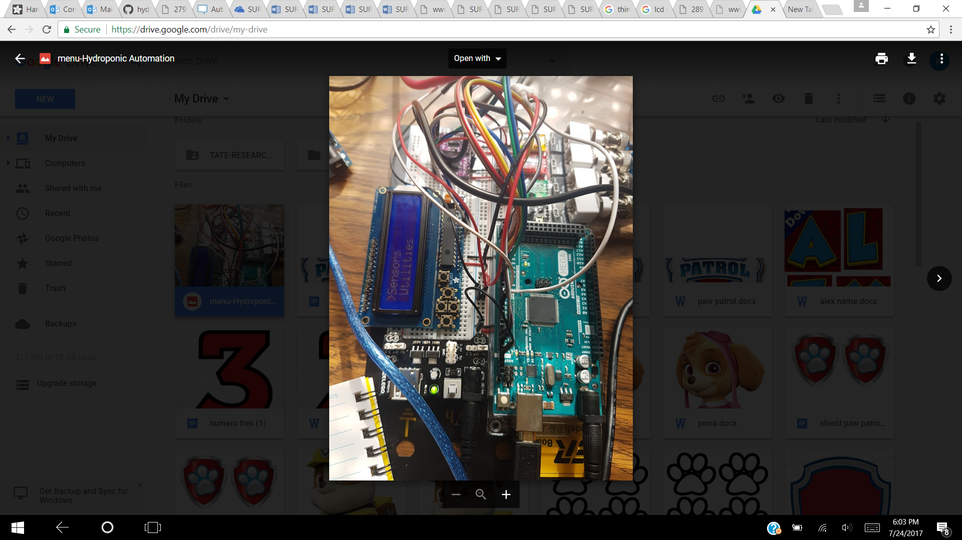
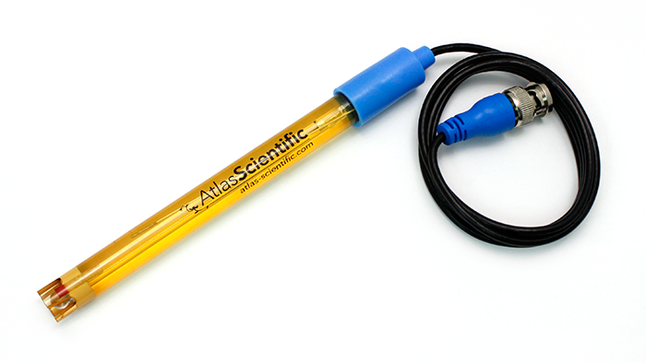
Design challenges
WIFI
MENU
CONDUCTIVITY SENSOR

Slide 6
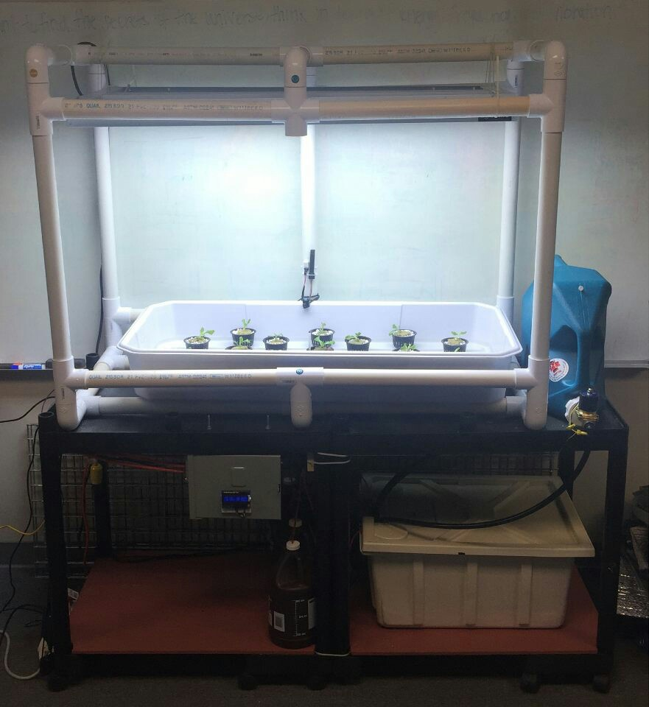
Final design

Slide 7
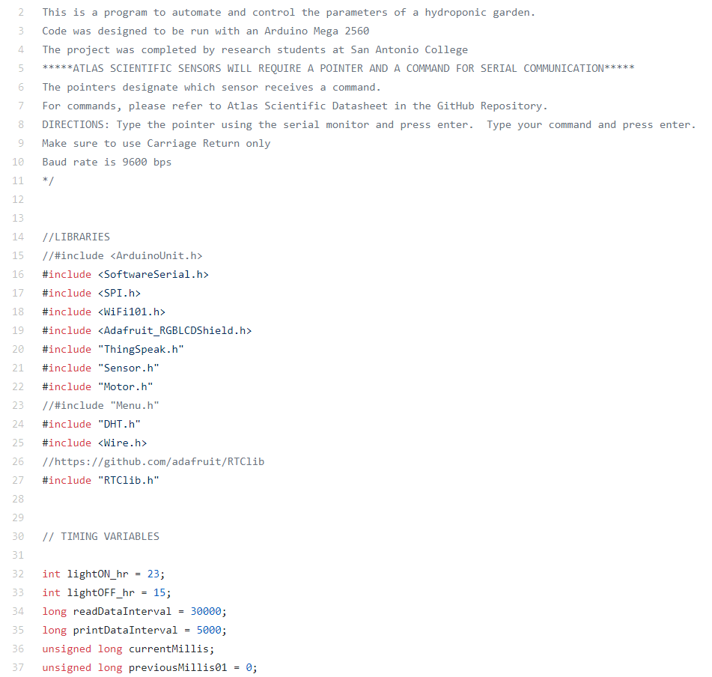
Testing
A successful system test was considered complete when several procedures happened
The first successful test was on August/ 1st /2017 at 1:30pm

Slide 8
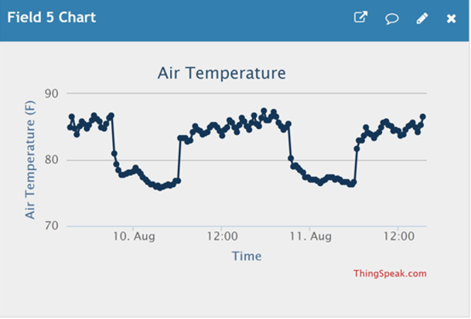
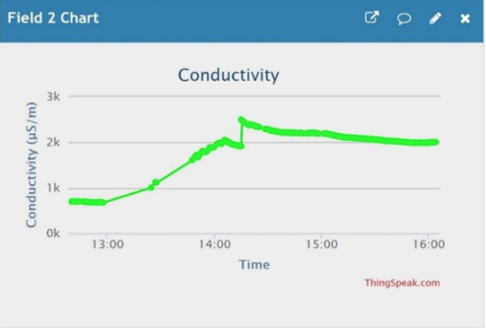
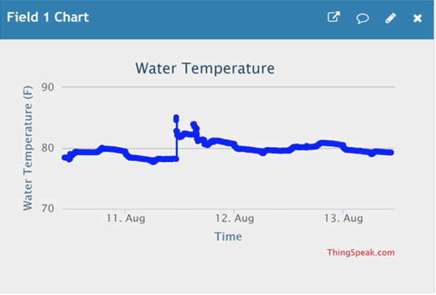
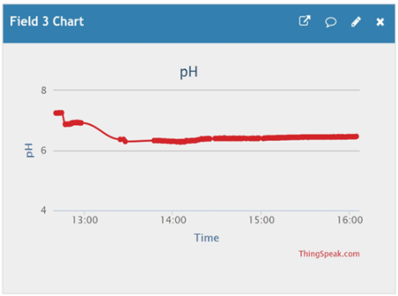
TEST RESULTS

Slide 9
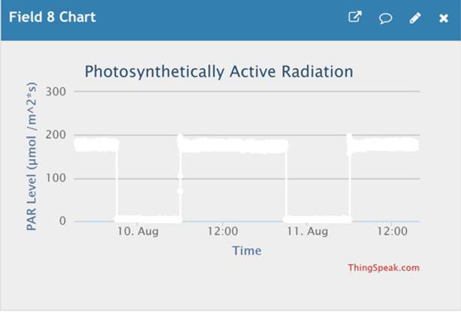
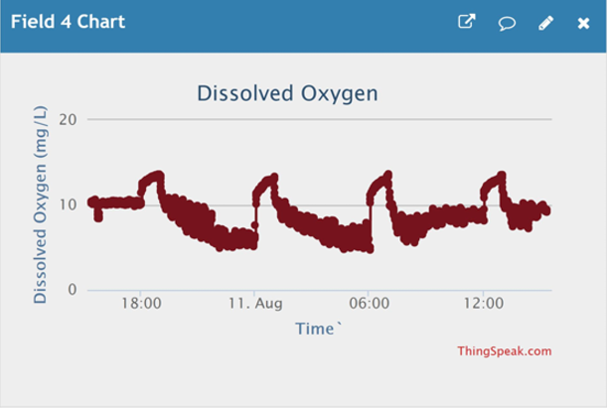
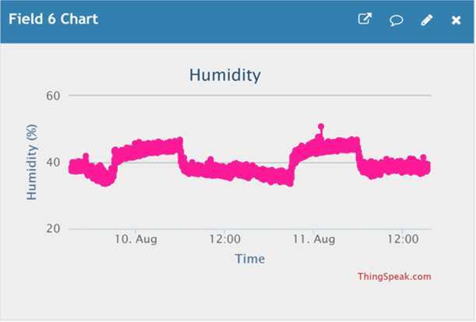
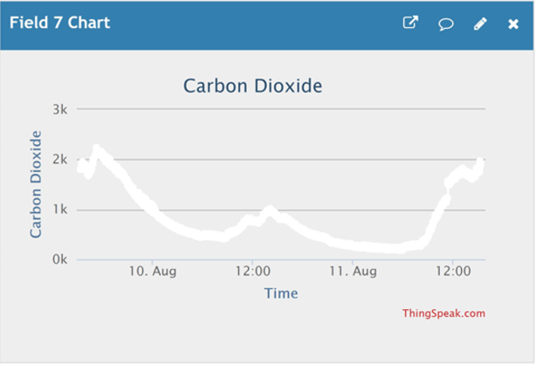
TEST RESULTS

Slide 10
RESEArCH RESULTS
The system successfully monitors the pH level, conductivity, air temperature, humidity, water temperature, dissolved oxygen, PAR and carbon dioxide
The pH level and conductivity of the solution are regulated automatically by the system
The system collects and sends reliable data to ThinkSpeak website through a WiFi module

Slide 11
Final design cost
The total cost of the automated hydroponic system is $2192

Slide 12
Conclusions and comments
A maximum of 25 plants can be grown in the tray at one time. This number can be increased without the addition of another controller
In total, it would take $2468.99 to purchase a comparable, ready-made controller system
The system can be used to conduct a variety of scientific research in the realm of hydroponics

Slide 13
Acknowledgement
Funding was provided by the National Science Foundation CIMA-LSAMP grant (Award No. 1305001), and The Alice Kleberg Reynolds Foundation. A special thanks to Pete R. Ortega, Steven Lewis, Amanda Lewis, and Dee Dixon for providing insight, leadership, and guidance. Thanks to San Antonio College and EcoCentro for granting access to vital materials and facilities for this project. Thanks to the members of the joint hydroponics research teams: Hydroponic Solutions and Effects of Three Light Treatments on Radishes and Basil. Their advice and support of this body of research was invaluable.

Slide 14
References
Adafruit. (2015, May 4). RGB LCD Shield Control a 16x2 Character LCD using 2 pins. Retrieved from https://learn.adafruit.com/rgb-lcd-shield?view=all
Arduino. (2017, August). Arduino Mega 2560. Retrieved from http://www.arduino.org/products/boards/arduino-mega-2560
GitHub. (2017, August 14). hydroponicAutomation. Retrieved from https://github.com/marshallamey/hydroponicAutomation
Hydrofarm (2017, August 14). IPonic 614 Environmental Controller. Retrieved from https://www.hydrofarm.com/p/LC99511
Particle. (2017, September 13). Photon Datasheet. Retrieved from https://docs.particle.io/datasheets/photon-datasheet/
ThingSpeak. (2017, August 7). Automated Hydroponic System. Retrieved from https://thingspeak.com/channels/298095
Ward, Tepher, Mata, Michelle & Williams, Juli. (2016, August 19). Solar hydroponics monitoring vehicles. Retrieved from http://reenergize.engineering.txstate.edu/projects/sac.html

Slide 15
QUESTIONS?

